Slide 1
A phylogenomic investigation of Scutellaria reveals distinct patterns in medicinal flavonoid diversity
Bryce Askey¹, Yeong Hun Song¹, Yoonkyung Lee², Ru Dai¹, Tong Geon Lee^{1,3,4}, Sangtae Kim², and Jeongim Kim^{1,3}
¹Horticultural Sciences Department, University of Florida, Gainesville, FL, USA
²Department of Biology, Sungshin Women’s University, Seoul, Republic of Korea
³Plant Molecular and Cellular Biology Graduate Program, University of Florida, Gainesville, FL, USA
⁴Gulf Coast Research and Education Center, University of Florida, Wimauma, FL, USA

Slide 2
Table S1. Source of Scutellaria tissue samples
Species | Condition | Organ | Source
S. alpina | Dried | Leaf, stem
S. altissima | Dried | Leaf
 | Fresh | Leaf, stem, root
S. angulosa | Dried
S. angustifolia ssp. angustifolia | Dried
S. angustifolia ssp. micrathum | Dried
S. antirrhinoides | Dried
S. arenicola | Dried
 | Fresh | Leaf, stem, root
S. astinae | Dried | Leaf, stem
S. baicalensis | Fresh | Leaf, stem, root
S. barbata | Fresh | Leaf, stem, root
S. blepharophylla | Dried
S. brittonii | Dried
S. californica | Dried
S. coccinea | Dried
S. coerulea | Dried | Leaf
S. costaricana | Dried | Leaf, stem
S. dependens | Fresh | Leaf, stem, root
S. discolor | Dried
S. drumondii | Dried
S. elliptica | Dried
S. epilobiifolia | Dried | Leaf, stem
S. formosa | Dried | Leaf, stem
S. fructicosa | Dried | Leaf
S. galericulata | Dried | Leaf, stem
S. glabriuscula | Dried
S. guatemalensis | Dried
S. hastifolia | Fresh | Leaf, stem, root
S. havanensis | Dried
 | Fresh | Leaf, stem, root
S. heterophylla | Dried
S. heydei | Dried
S. hispidula | Dried
S. holmgreniorum | Dried | Leaf, stem
S. hookeri | Dried | Leaf, stem
S. incanca | Dried
S. indica var. coccinea | Fresh | Leaf, stem, root
S. insignis | Fresh | Leaf, stem, root
S. integrifolia | Dried
S. isochelia | Dried | Leaf, stem
S. javalambrensis | Dried
S. javanica | Dried
S. lateriflora | Dried | Leaf
 | Fresh | Leaf, stem, root
S. leonardii | Dried
 | Fresh | Leaf, stem, root
S. leptosiplonsipkon | Dried
S. longifolia | Dried | Leaf, stem
S. lutea | Dried
S. lutilaba | Dried | Leaf, stem
S. microphylla | Dried | Leaf, stem, root
S. multicularis | Dried
S. multiglandulosa | Dried
S. multiglandulosa | Dried
S. muriculata | Dried

Slide 3
Table S1 cont. Source of Scutellaria tissue samples
Species | Condition | Organ | Source
S. oblonga | Dried
S. orientalis | Dried | Leaf, stem
S. ovata | Dried | Leaf
S. parvula | Dried | Leaf, stem
S. paucifolia | Dried
S. pekenensis var. alpina | Fresh | Leaf, stem, root
S. peregrina | Dried
S. pinnatifida | Dried
S. potosina | Dried | Leaf, stem
S. prostrata | Dried
S. przewalskii | Dried
S. pseudoserrata | Dried
S. pulchella | Dried | Root
S. purpurascens | Dried
S. racemosa | Dried
 | Fresh | Leaf, stem, root
S. relenorskyi | Dried
S. resinosa | Dried | Leaf, stem
S. sapphirina | Dried | Leaf, stem
S. scordiifolia | Dried
S. seleriana | Dried
S. serrata | Dried | Leaf
S. siphocampuloides | Dried | Leaf, stem
S. splendens | Dried | Leaf
S. strigillosa | Fresh | Leaf, stem, root
S. suffrutscens | Dried
S. sumatrana | Dried
S. tessellata | Dried | Leaf, stem
S. tournefortii | Fresh | Leaf, stem, root

Slide 4
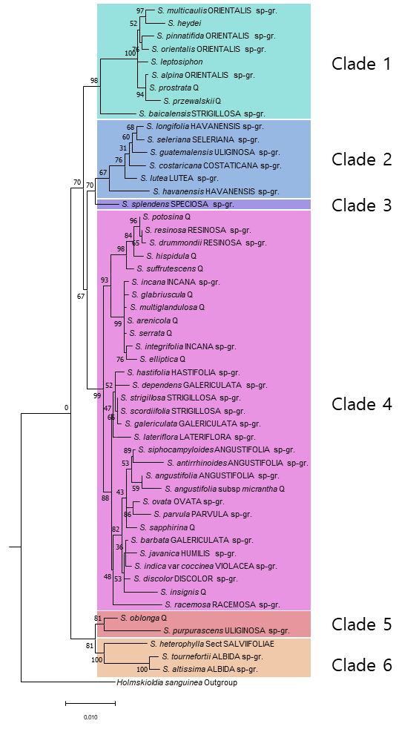
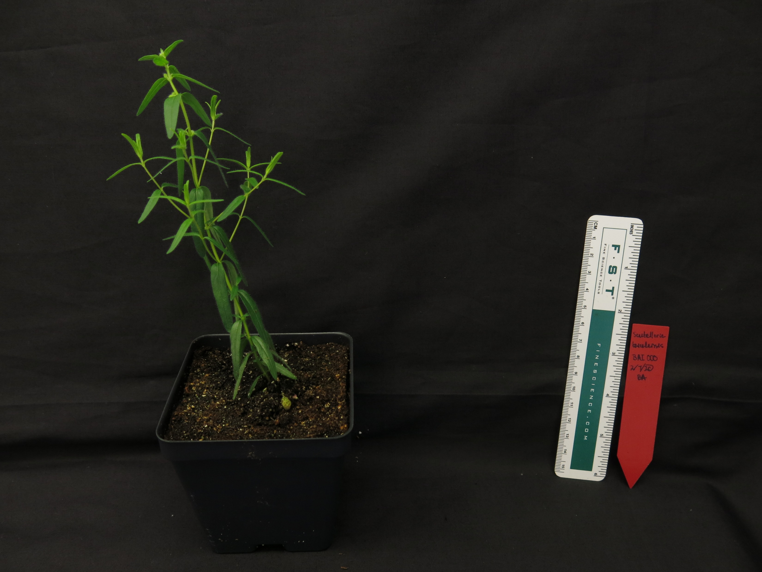
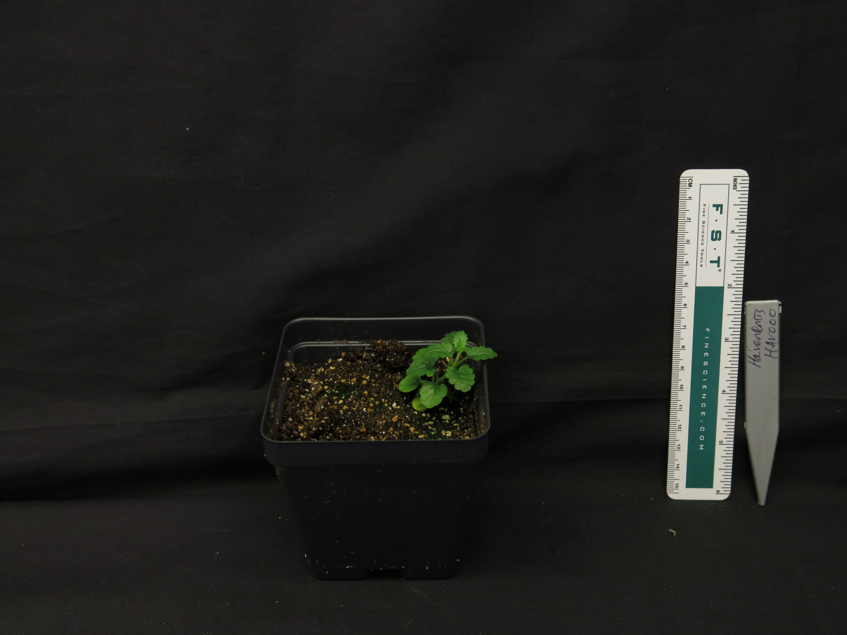
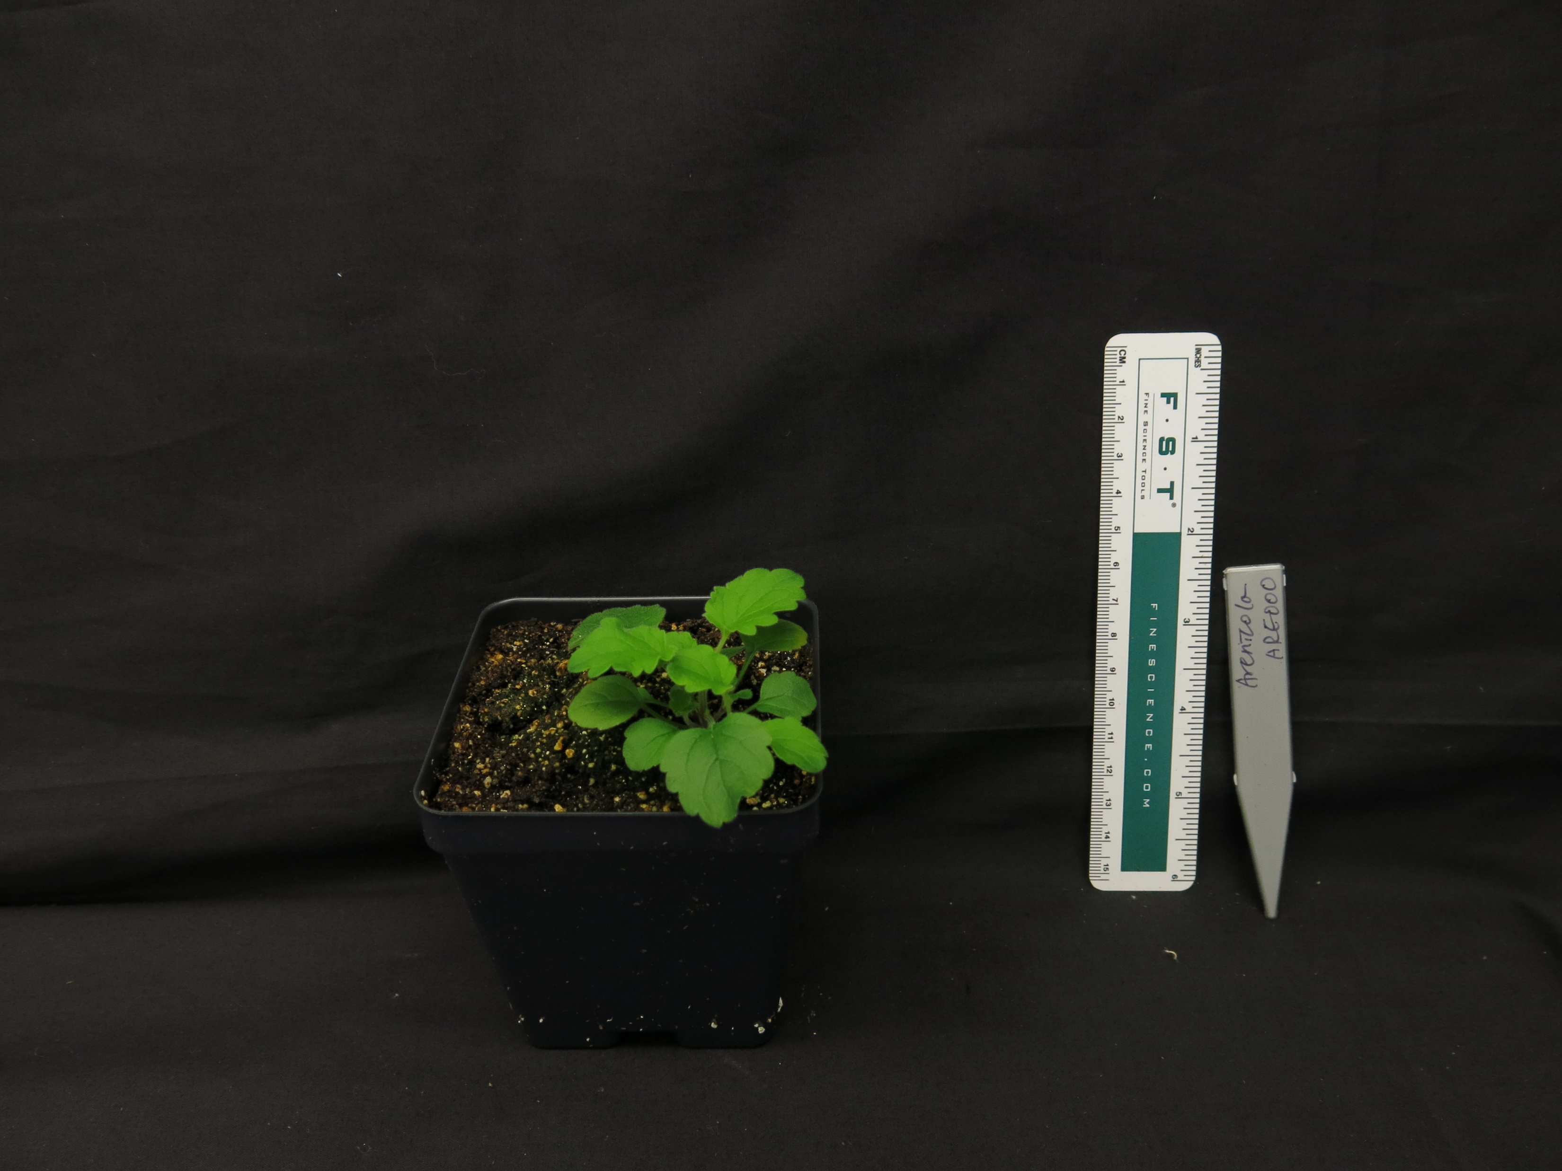
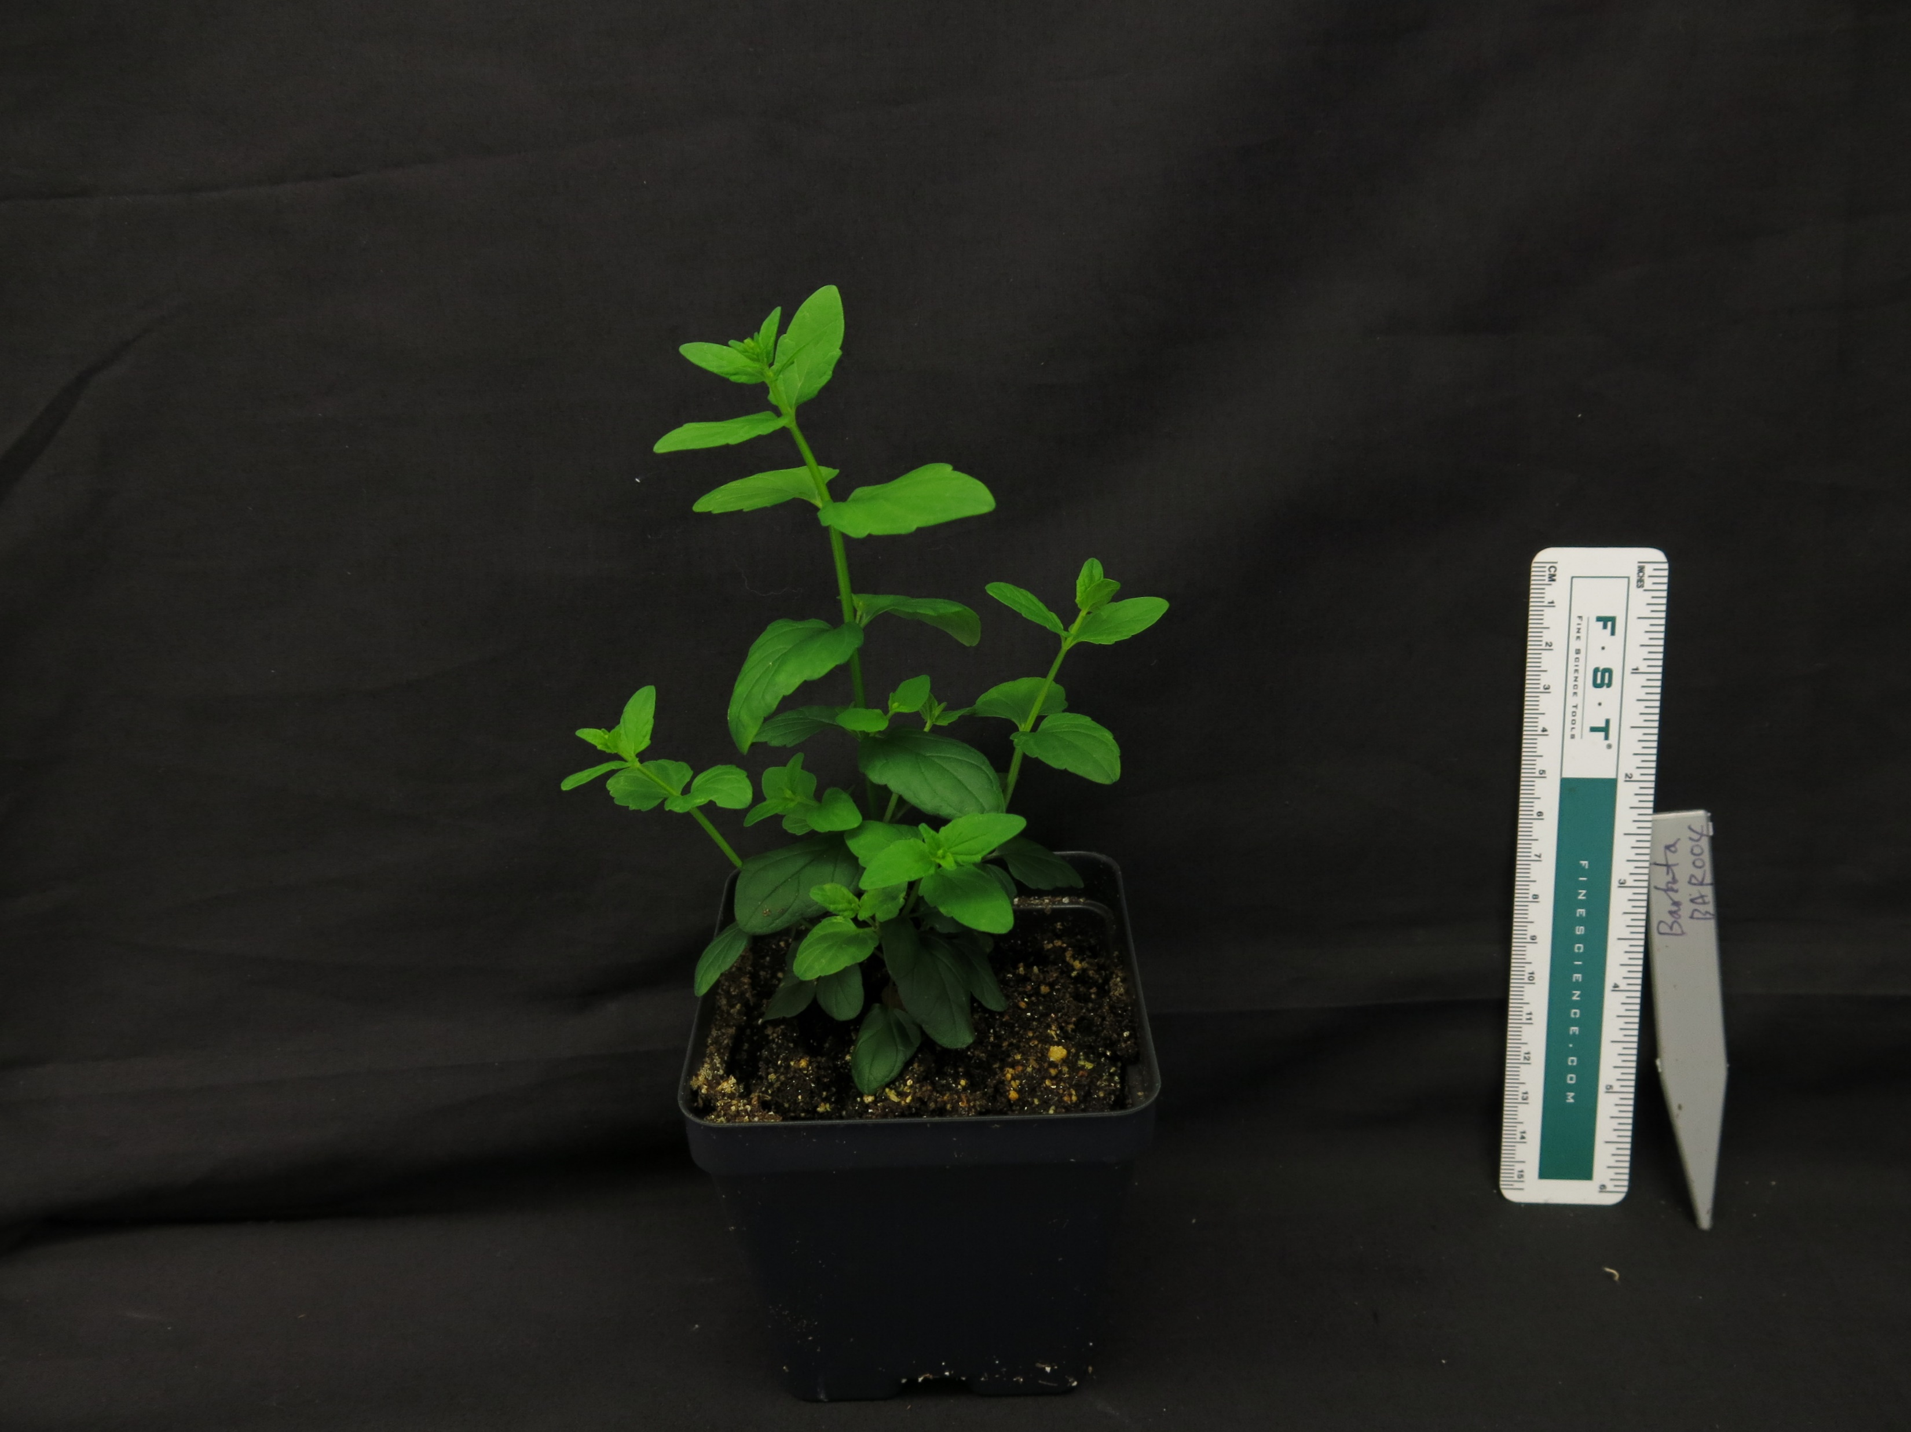
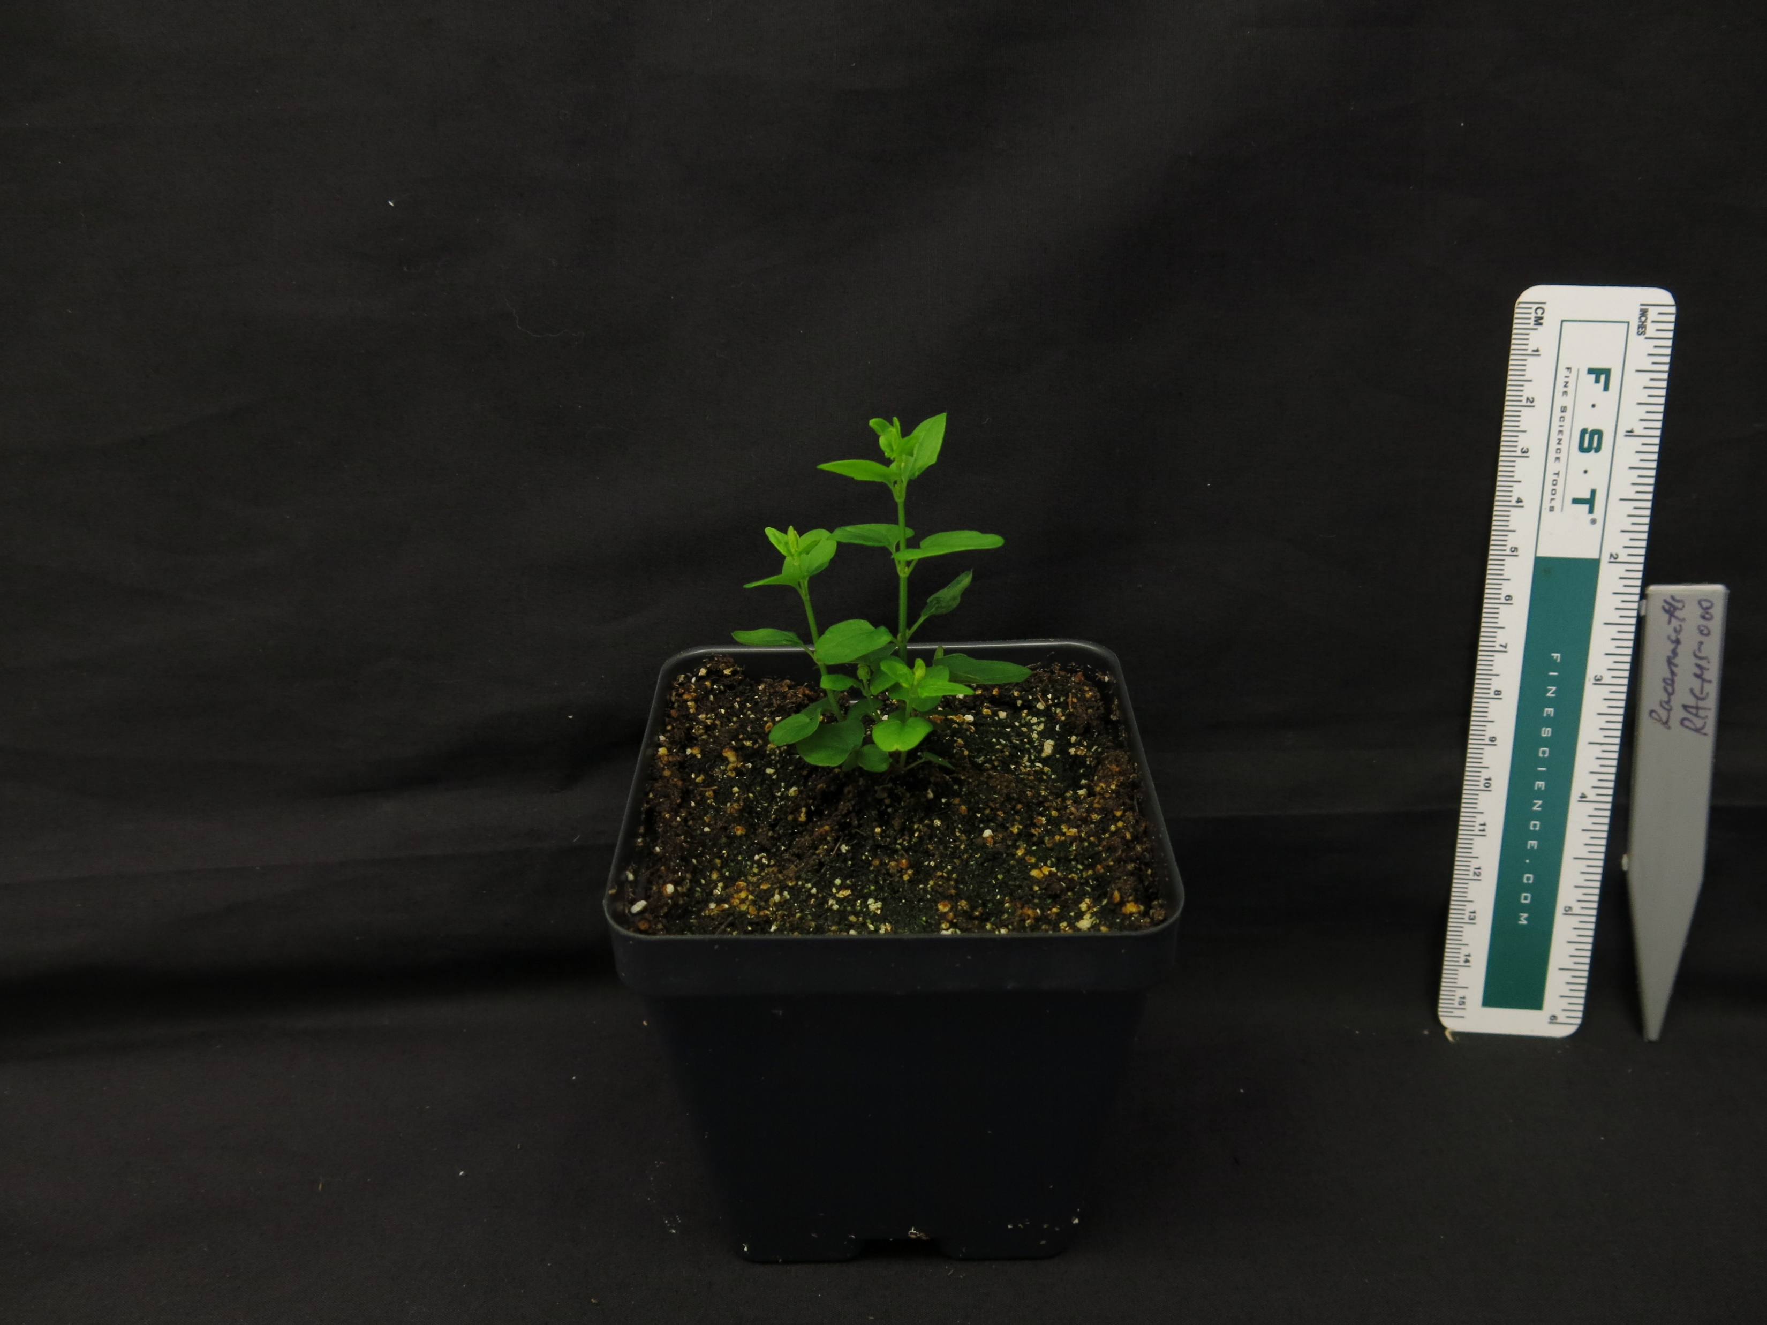
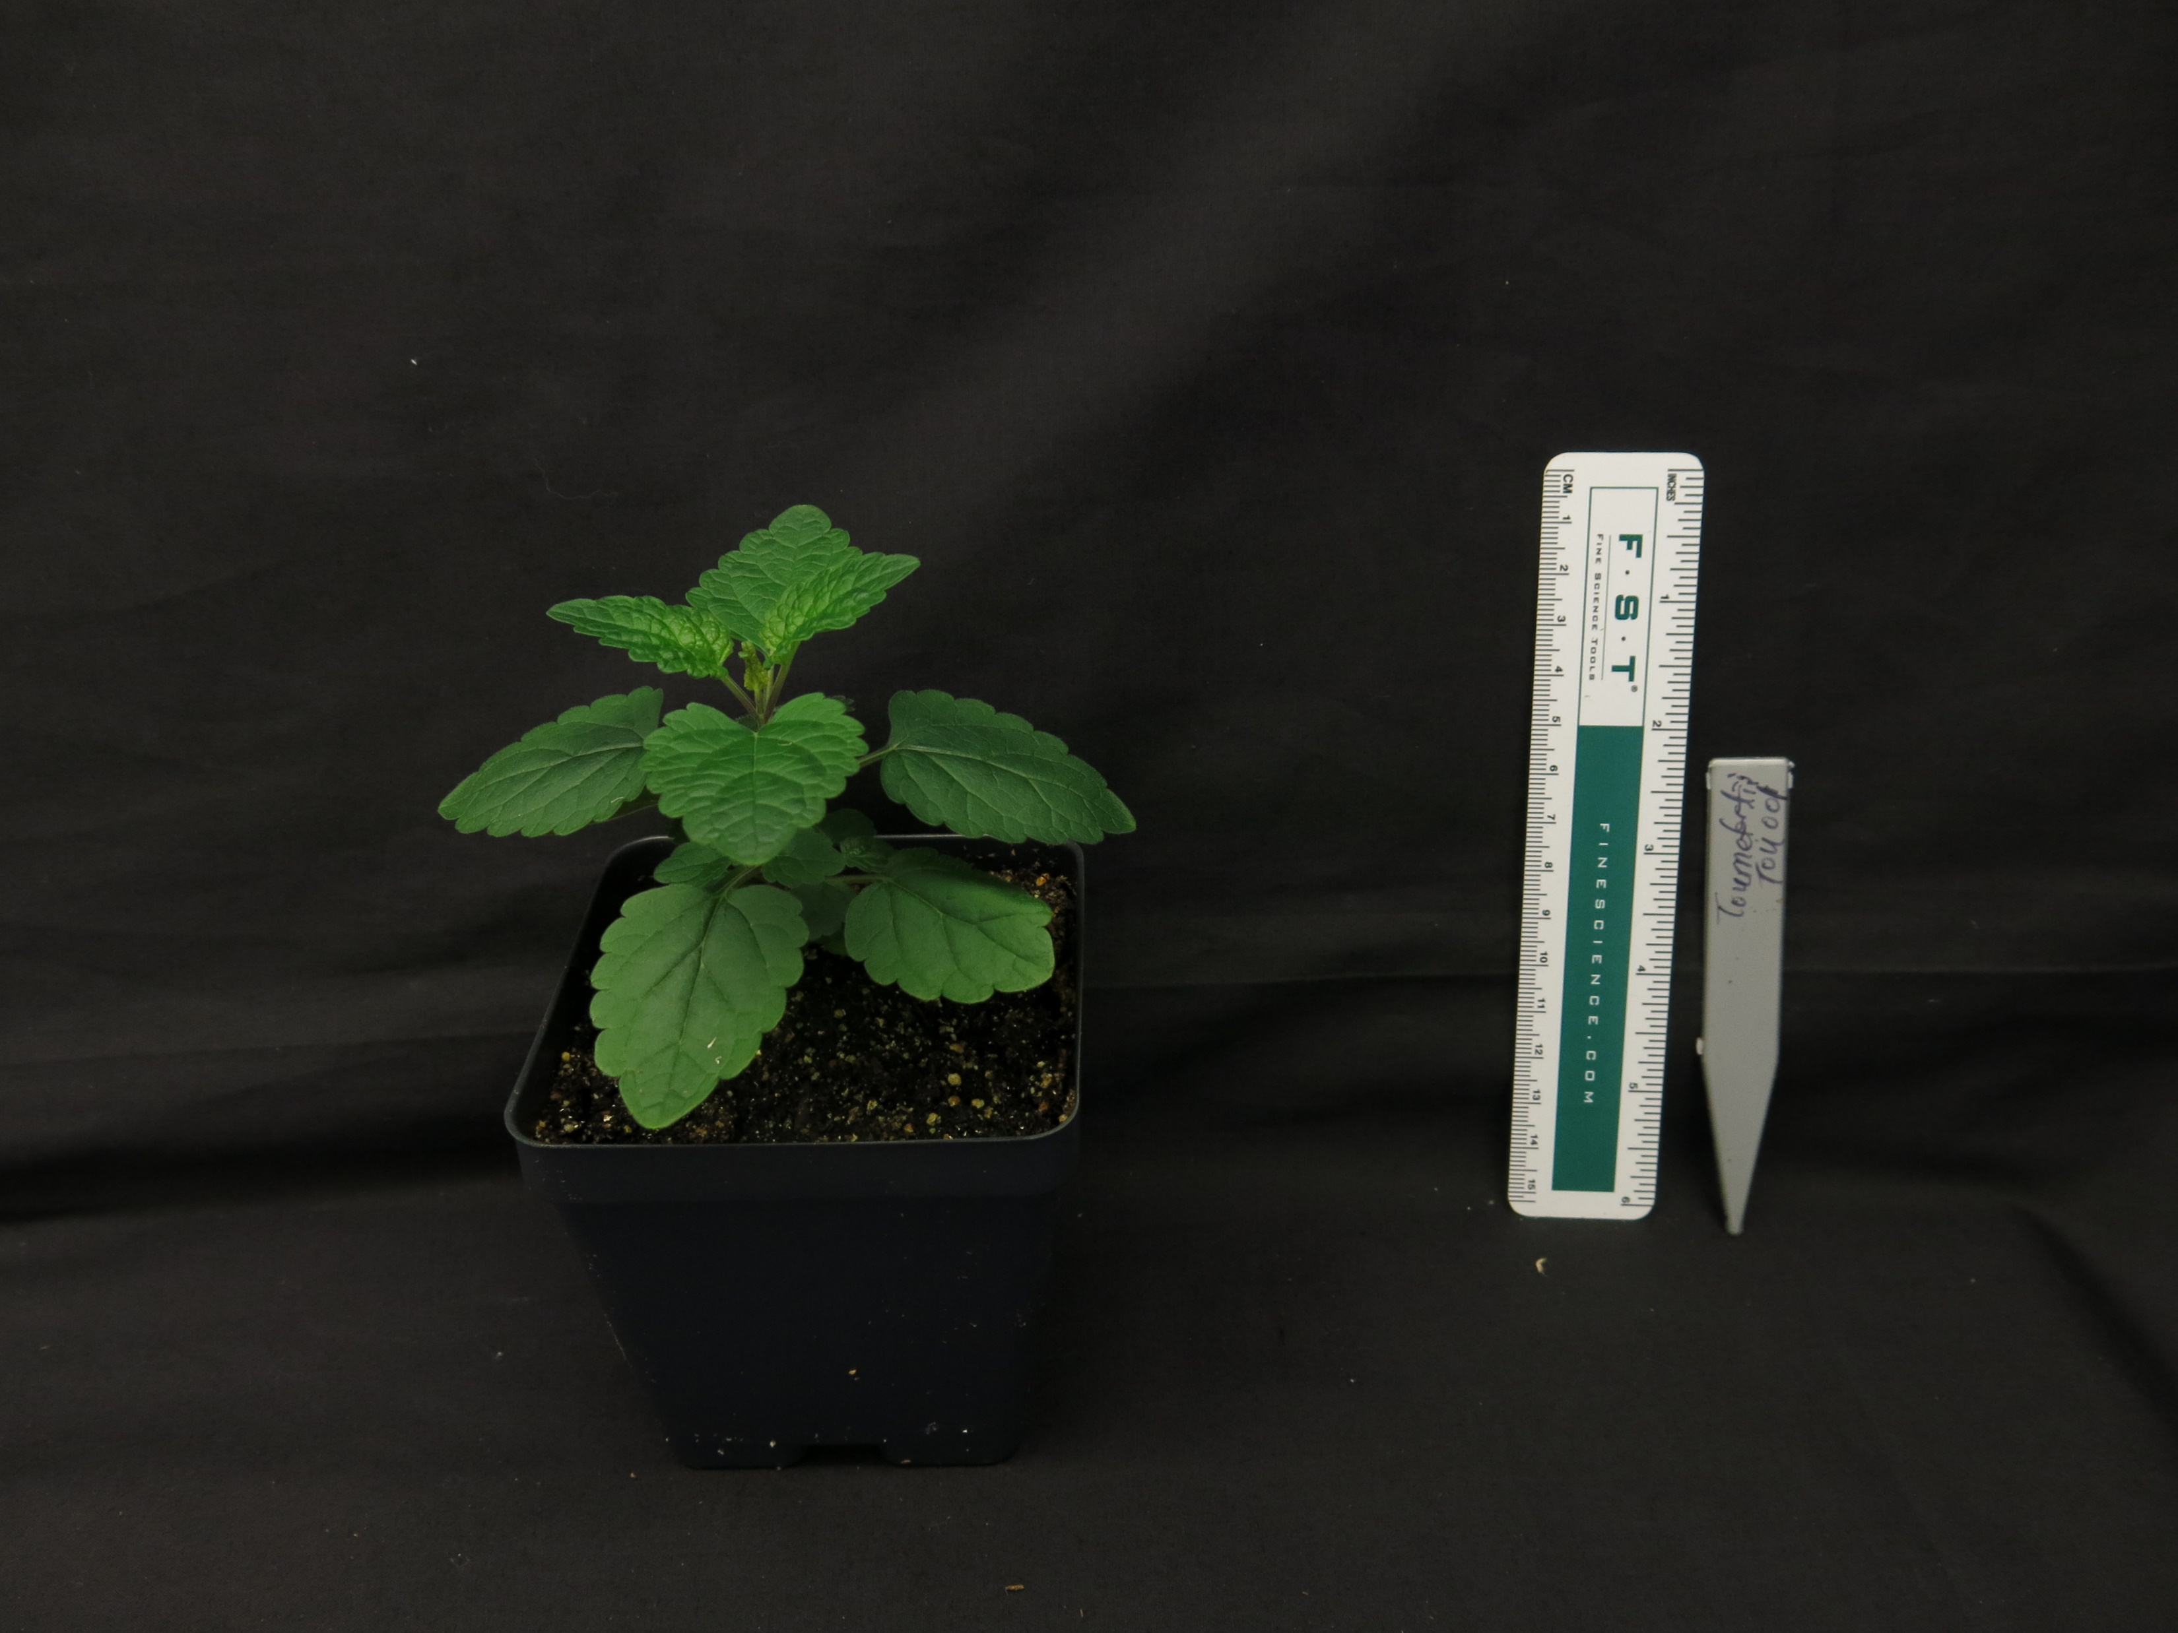
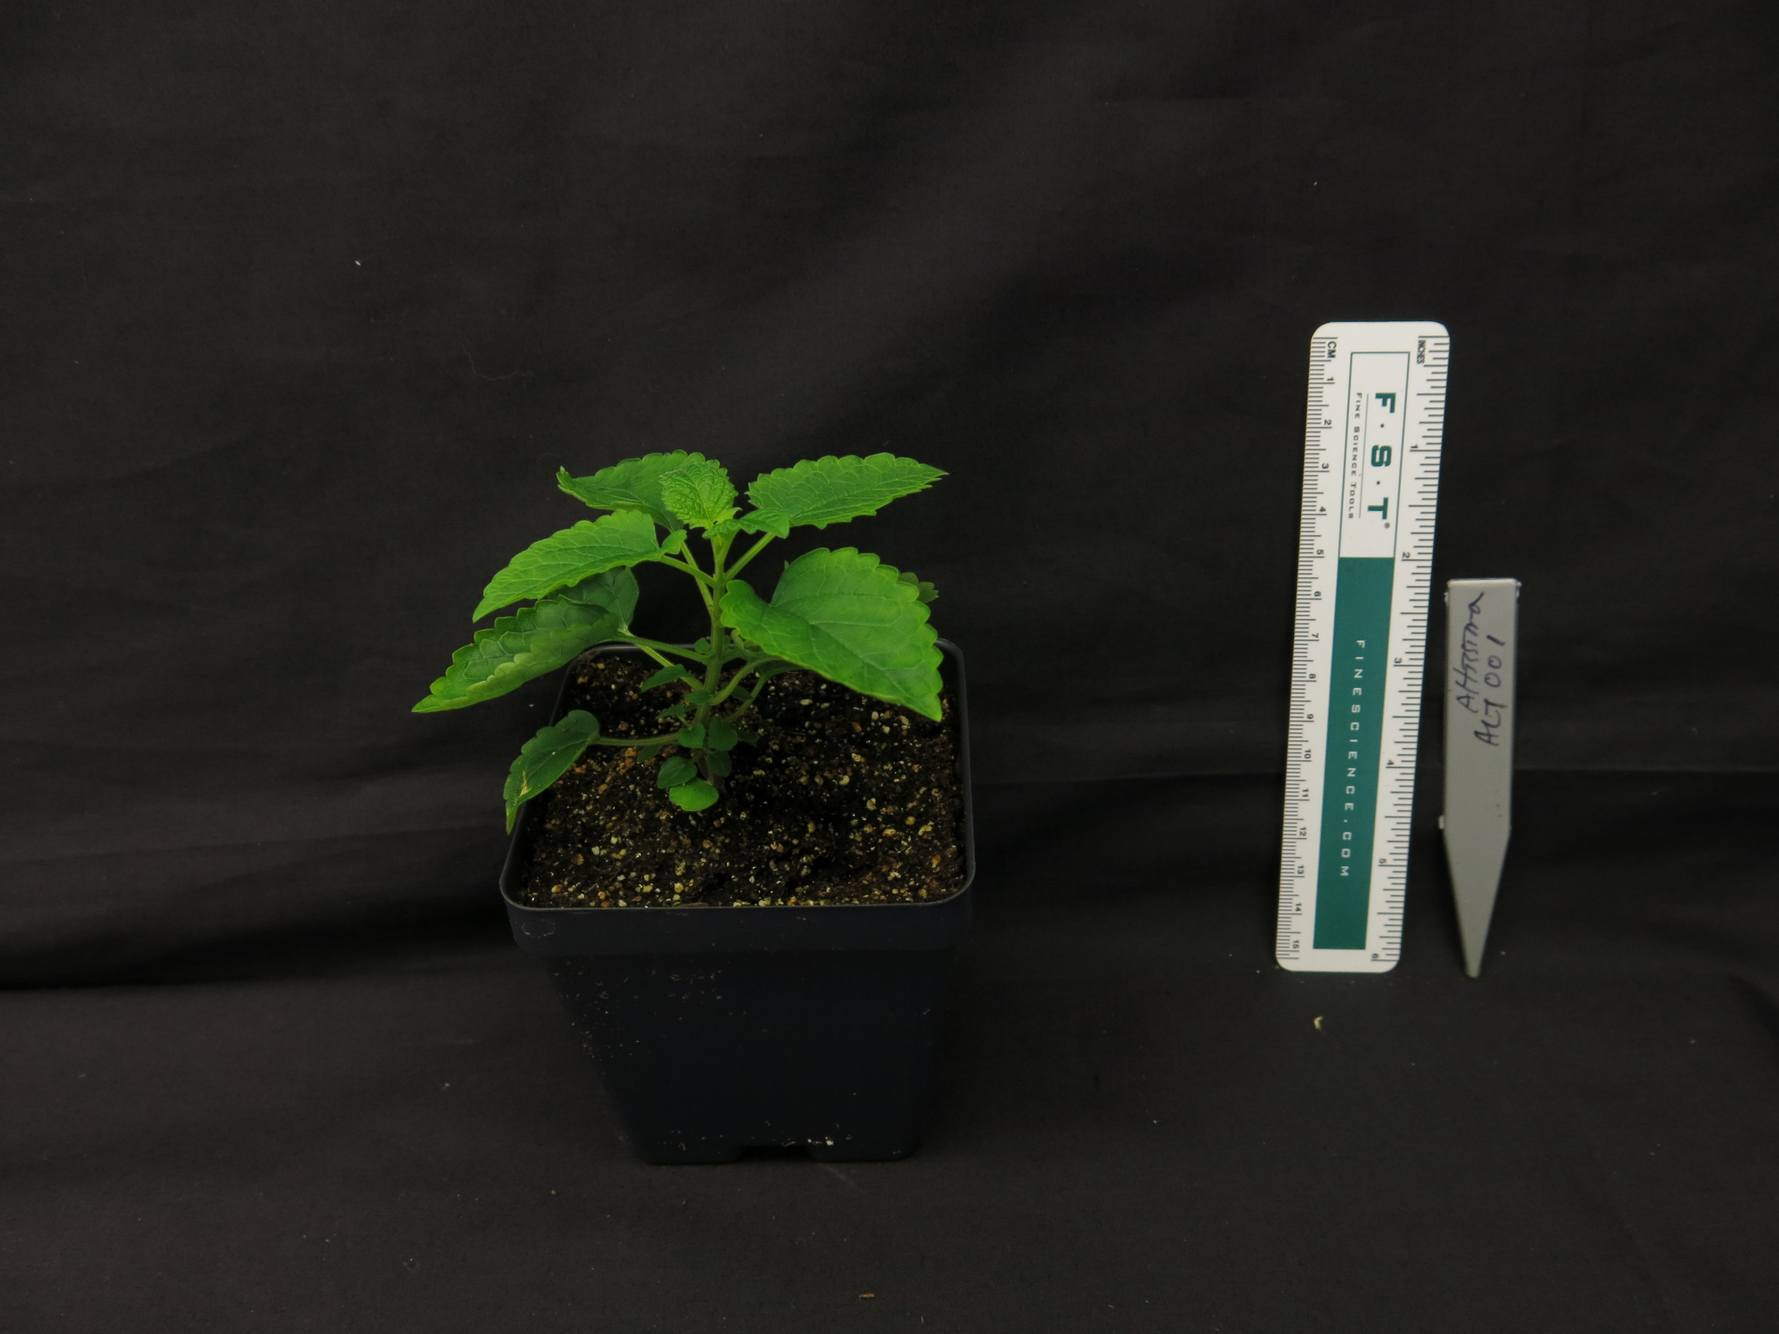
A.
B.
S. baicalensis
S. havanensis
S. arenicola
S. barbata
S. racemosa
S. tournefortii
S. altissima
Figure 1. (A) Maximum likelihood tree inferred from chloroplast genome data for 52 species of Scutellaria. To facilitate downstream analysis, the tree is subdivided into 6 clades. (B) Representative images of 7 species of Scutellaria. Colored circles next to species names indicate the clade which the species belongs to.

Slide 5
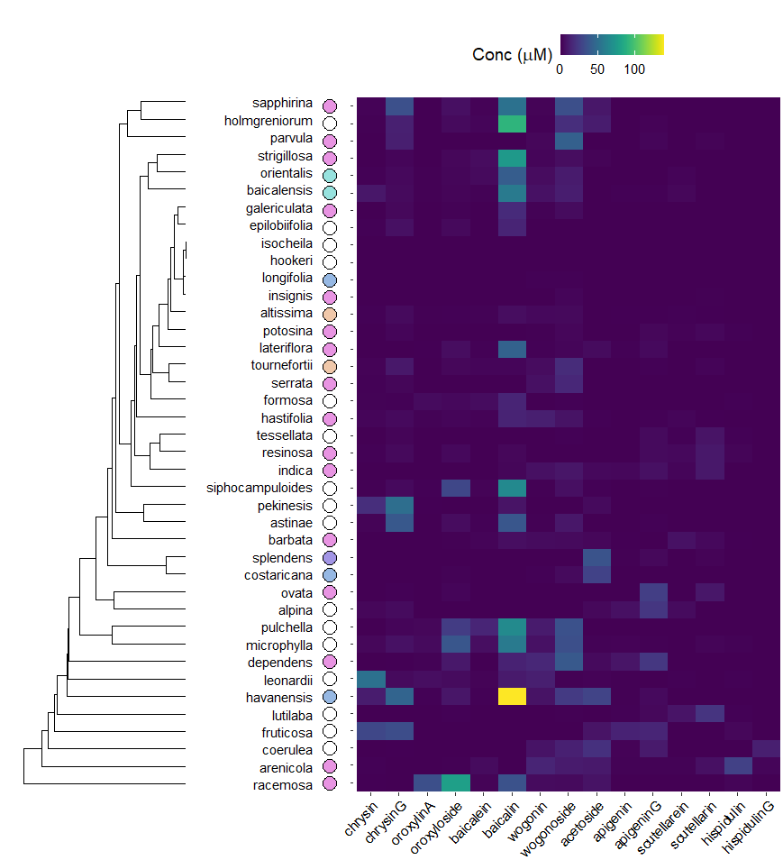
Figure 2. Heatmap of overall flavonoid concentrations measured with High Performance Liquid Chromatography (HPLC) of … species of Scutellaria. Ordering of species was determined by hierarchical clustering based on flavonoid concentration, as illustrated by the dendrogram to the right of the figure. Colored circles next to species names indicate phylogenetic clade, as shown in Figure 1. An empty circle indicates that the species was not included in the tree from Figure 1. Data for fresh tissue samples is shown at 5000 ppm (5 mg sample / 1 mL solvent). Data for herbarium tissue samples is shown at 500 ppm (0.5 mg sample / 1 mL solvent).

Slide 6
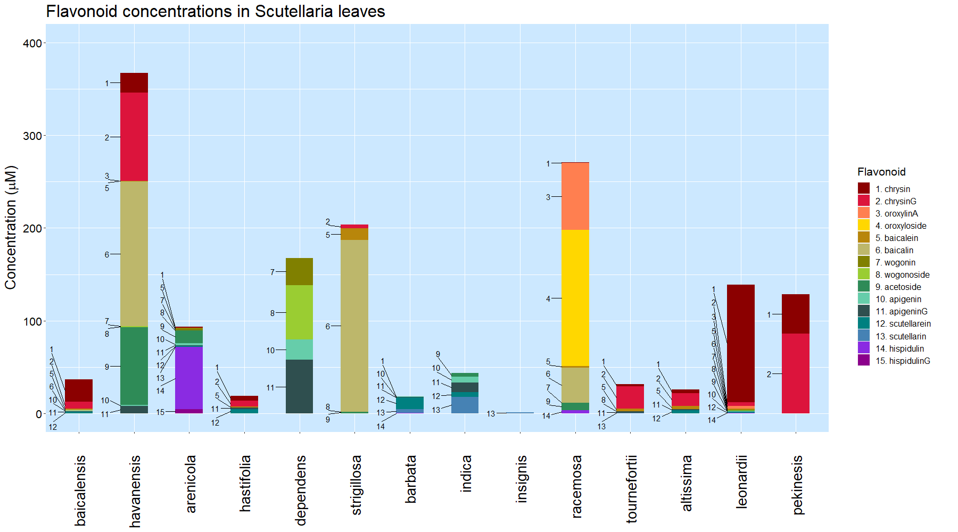
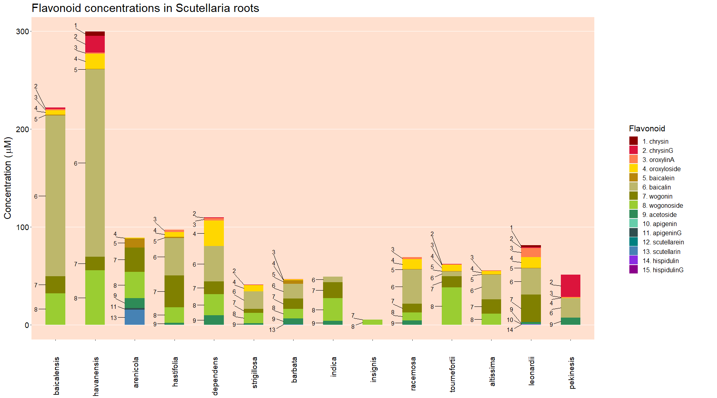
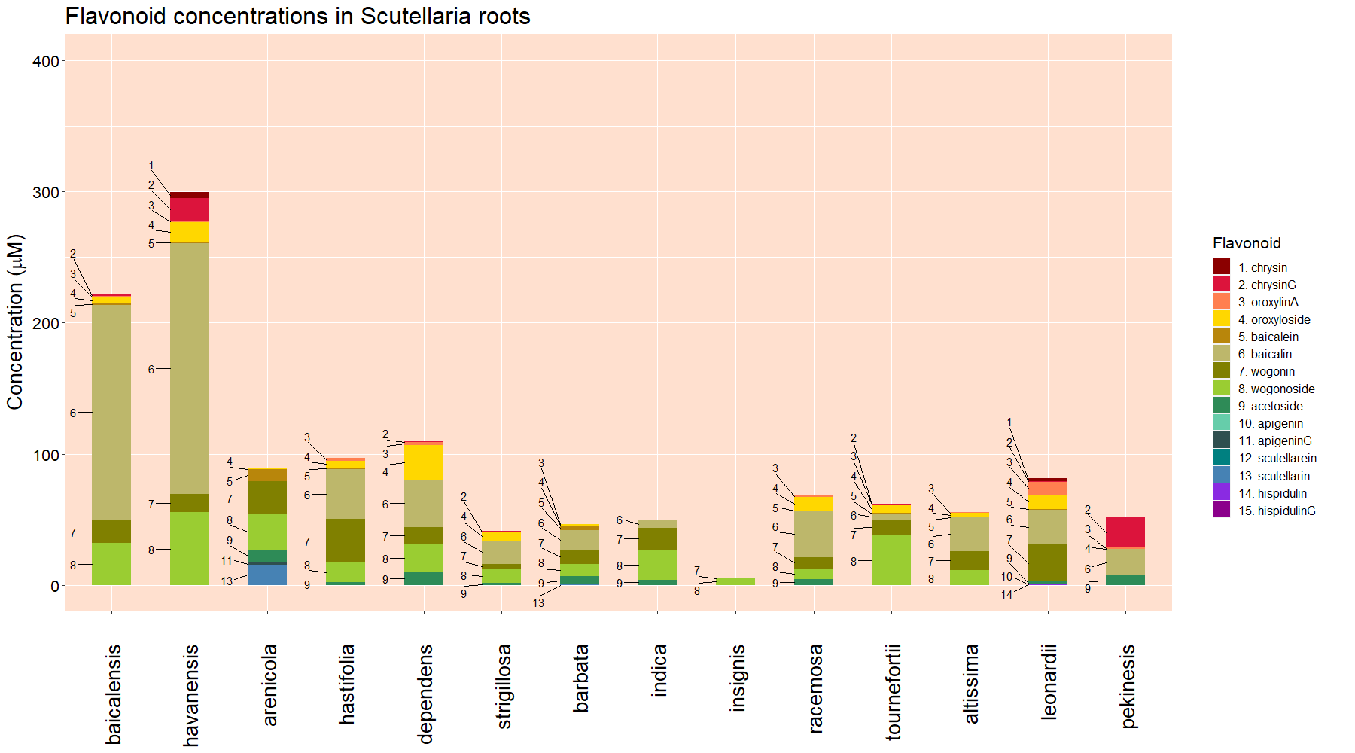
Leaves
Roots
Figure 3. Organ-specific flavonoid data collected from 14 Scutellaria species via High Performance Liquid Chromatography (HPLC). Species are ordered based on phylogenetic relationship determine from chloroplast genome data, shown in Figure 1. Colored circles next to species names indicate phylogenetic clade, as shown in Figure 1. An empty circle indicates that the species was not included in the tree from Figure 1.

Slide 7
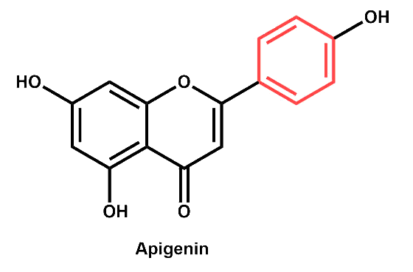
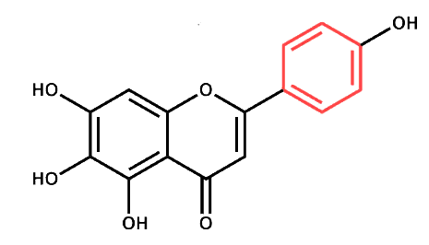
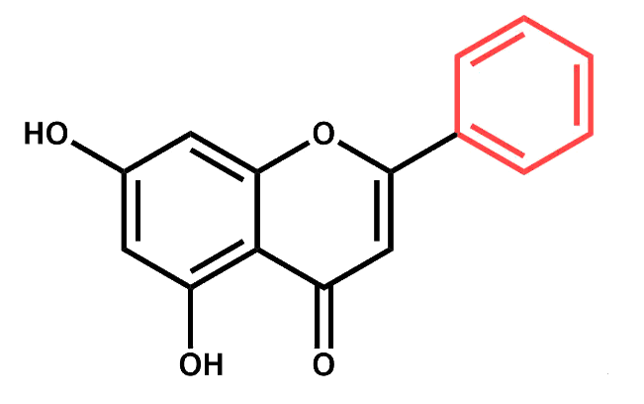
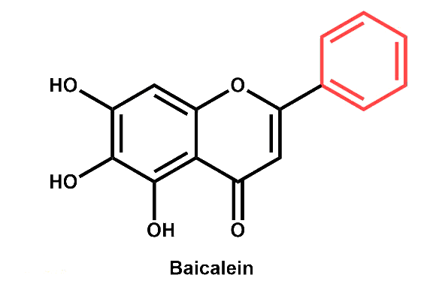
Published
Proposed to occur in shoots
Proposed to occur in roots
4-coumarate
Apigenin
Scutellarein
Phenylalanine
Cinnamic acid
Cinnamoyl-CoA
Chrysin
Baicalein
Figure 4. Proposed

Slide 8
Table 1. Genome sizes as estimated by flow cytometry. Cell colors indicate phylogenetic clade, as shown in Figure 1.
Species | Genome size (Gbp) | Source
S. baicalensis | 0.54 | This study
S. havanensis | 0.37 | This study
S. arenicola | 0.85 | This study
S. hastifolia | 0.39 | This study
S. dependens | 0.44 | This study
S. strigillosa | 0.39 | Lee, Kim (2017)
S. barbata | 0.52 | This study
S. indica | 0.37 | Lee, Kim (2017)
S. insignis | 0.47 | Lee, Kim (2017)
S. racemosa | 0.44 | This study
S. tournefortii | 0.39 | This study
S. altissima | 0.39 | This study
S. leonardii | 0.50 | This study
S. pekenensis | 0.38 | This study

